Slide 1
CX2101 Algorithm Design and Analysis
Tutorial 2 (Graphs)
Week 7: Q4-Q6

Slide 2
This Tutorial
Minimum spanning tree algorithm – Prim’s
Minimum spanning tree - concept

Slide 3
Question 4
Execute Prim’s minimum spanning tree algorithm by hand on the graph below starting at vertex G.
Show the contents of arrays S, d and pi after each iteration of the while loop when a vertex is added to the MST.
2
A
B
7
3
6
4
G
F
1
3
2
C
D
E
5
4
2

Slide 4
2
B
A
7
3
6
4
1
G
3
2
After initialization:
First iteration:
F
C
5
D
E
4
2
 | A | B | C | D | E | F | G
S | 0 | 0 | 0 | 0 | 0 | 0 | 1
d | ∞ | ∞ | ∞ | ∞ | ∞ | ∞ | 0
pi | Null | Null | Null | Null | Null | Null | Null
2
B
A
7
3
6
4
1
G
3
F
2
C
5
D
E
4
 | A | B | C | D | E | F | G
S | 0 | 0 | 0 | 0 | 0 | 0 | 1
d | 3 | 6 | ∞ | 1 | 3 | ∞ | 0
pi | G | G | Null | G | G | Null | Null
2

Slide 5
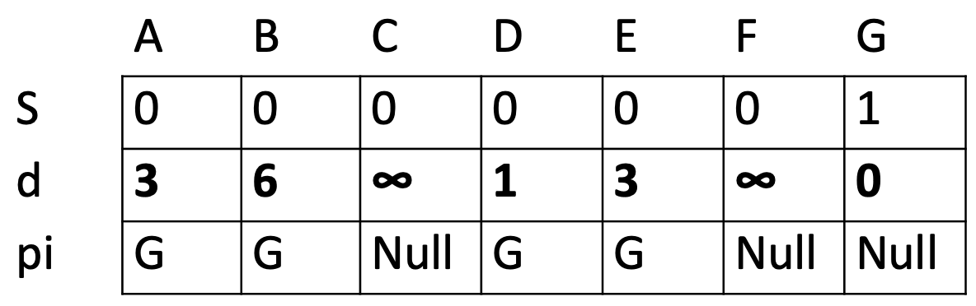
2
B
previous
iteration
A
7
3
6
4
1
G
3
F
2
C
5
D
E
2
2nd iteration: Edge GD becomes part of the MST
3rd iteration: Edge DE becomes part of the MST
 | A | B | C | D | E | F | G
S | 0 | 0 | 0 | 1 | 0 | 0 | 1
d | 3 | 6 | ∞ | 1 | 2 | 5 | 0
pi | G | G | Null | G | D | D | Null
2
B
A
7
3
6
4
1
G
3
F
2
C
5
D
E
2
 | A | B | C | D | E | F | G
S | 0 | 0 | 0 | 1 | 1 | 0 | 1
d | 3 | 6 | 2 | 1 | 2 | 5 | 0
pi | G | G | E | G | D | D | Null

Slide 6
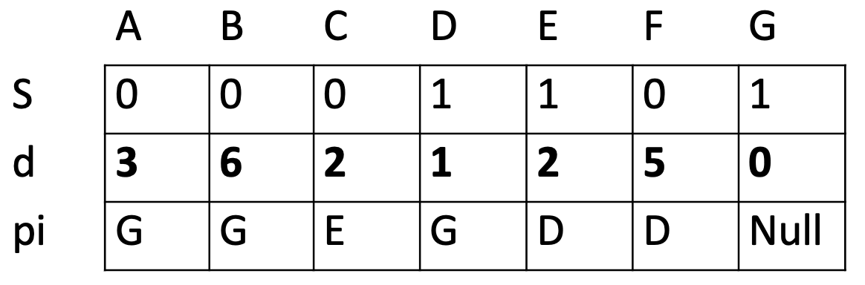
2
B
previous
iteration
A
7
3
6
4
1
G
3
F
2
C
5
D
E
2
4th iteration: Edge EC becomes part of the MST
5th iteration: Edge GA becomes part of the MST
 | A | B | C | D | E | F | G
S | 0 | 0 | 1 | 1 | 1 | 0 | 1
d | 3 | 4 | 2 | 1 | 2 | 5 | 0
pi | G | C | E | G | D | D | Null
2
B
A
7
3
6
4
1
G
3
F
2
C
5
D
E
2
 | A | B | C | D | E | F | G
S | 1 | 0 | 1 | 1 | 1 | 0 | 1
d | 3 | 2 | 2 | 1 | 2 | 5 | 0
pi | G | A | E | G | D | D | Null

Slide 7
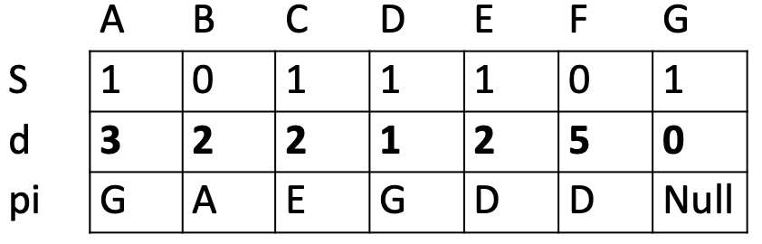
2
B
A
previous
iteration
7
3
6
4
1
G
3
F
2
C
5
D
E
2
6th iteration: Edge AB becomes part of the MST
7th iteration: Edge DF becomes part of the MST
 | A | B | C | D | E | F | G
S | 1 | 1 | 1 | 1 | 1 | 0 | 1
d | 3 | 2 | 2 | 1 | 2 | 5 | 0
pi | G | A | E | G | D | D | Null
2
A
B
7
3
6
4
1
G
3
F
2
C
5
D
E
2
 | A | B | C | D | E | F | G
S | 1 | 1 | 1 | 1 | 1 | 1 | 1
d | 3 | 2 | 2 | 1 | 2 | 5 | 0
pi | G | A | E | G | D | D | Null

Slide 8
Question 5
In a weighted undirected graph, is the path between two vertices in a minimum spanning tree always the shortest path (i.e. a path with the minimum weight) between the two vertices in the graph?
If your answer is yes, give a proof;
otherwise, give a counterexample.

Slide 9
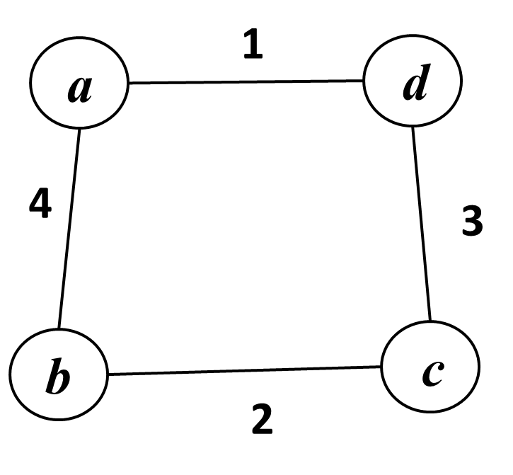
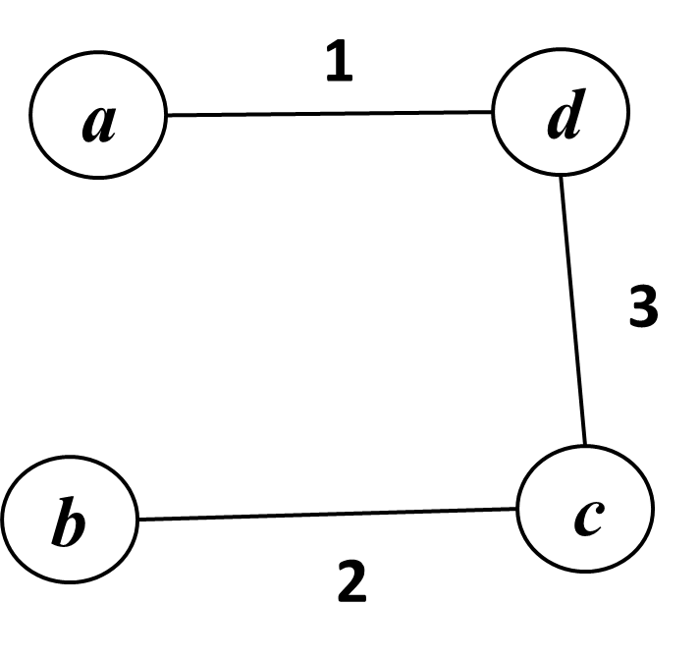
Answer: No, it is not always the case.
A counterexample:
The path from vertex a to vertex b in the MST is (a, d, c, b) with weight 1 + 3 + 2 = 6.
But the shortest path from a to b in the graph is (a, b) with weight 4, shorter than the path in the MST.
A weighted graph
Minimum Spanning Tree (MST)

Slide 10
Question 6
Draw a connected graph with five nodes, six edges of respective weights 5, 6, 7, 8, 9, 10, and a minimum spanning tree of weight 28.
Is it possible to have an MST of weight 29?
If yes, draw the graph;
otherwise, provide your justification.

Slide 11
MST Property
Minimum Spanning Tree Property
Let T be a spanning tree of G, where G = (V, E, W) is a connected, weighted graph. Suppose that for every edge (u, v) of G that is not in T, if (u, v) is added to T it creates a cycle such that (u, v) is a maximum-weight edge on that cycle. Then T has the Minimum Spanning Tree Property (or MST Property, in short).
A
2
A
B
A
2
B
B
3
2
1
3
2
1
3
2
C
D
C
D
C
D
4
✓ MST Property
✗ MST Property
G

Slide 12
Theorem 1
Theorem 1: In a connected weighted graph G = (V, E, W), a tree T is a minimum spanning tree if and only if T has the MST property.

Slide 13
Edge weights: 5, 6, 7, 8, 9, 10
MST of weight 28: 5, 6, 7, 10 or 5, 6, 8, 9
a
5
b
a
5
b
10
7
6
e
8
6
e
9
10
7
9
8
c
d
c
d

Slide 14
Edge weights: 5, 6, 7, 8, 9, 10
MST of weight 29: 5, 6, 8, 10
a
5
b
8
6
e
7
10
c
9
d

Slide 15
What we have exercised
Minimum spanning tree algorithm
Prim’s algorithm
Running of the algorithm
Data structure contents in each iteration
Path in MST may not be a shortest path in G
Minimum spanning tree – concept
Understand which edges may or may not be in an MST

